Slide 1
JAVA 2D/3D Project01
s1300030 Kohei Kuwana

Slide 2
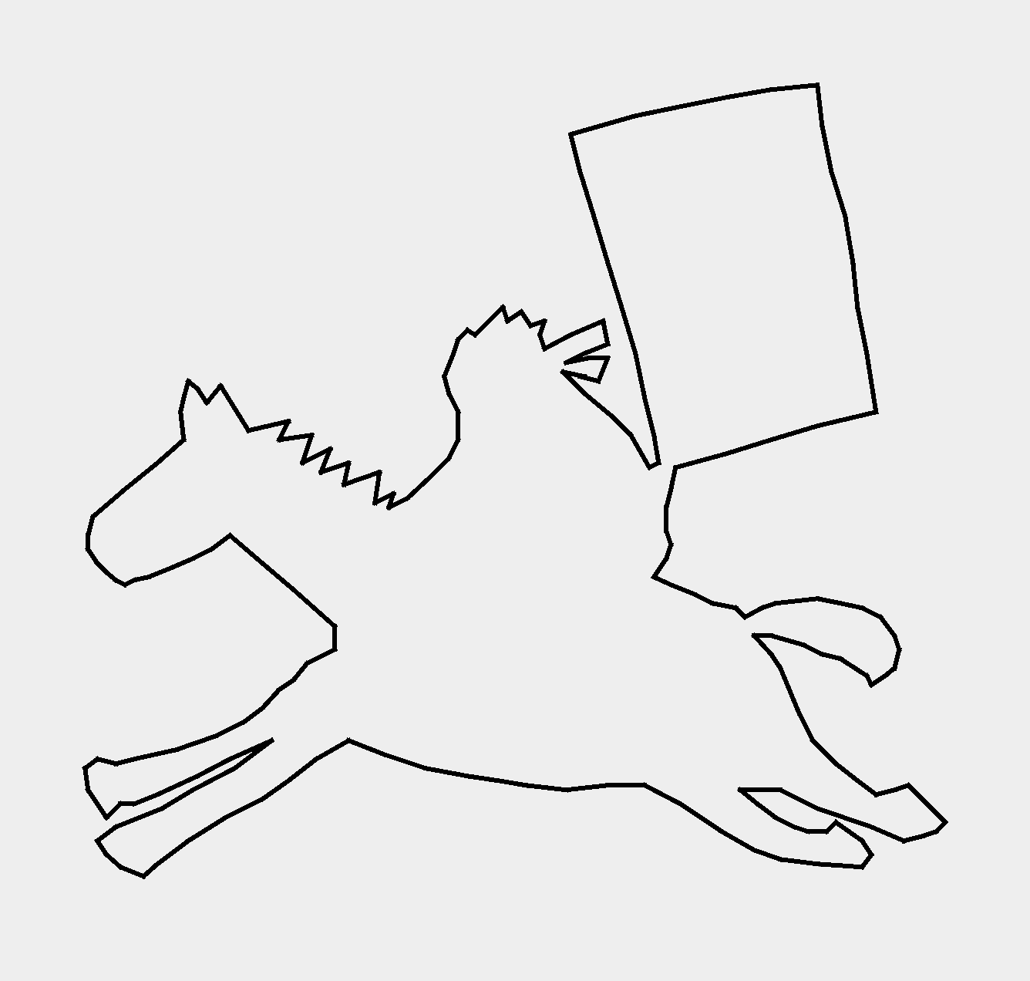
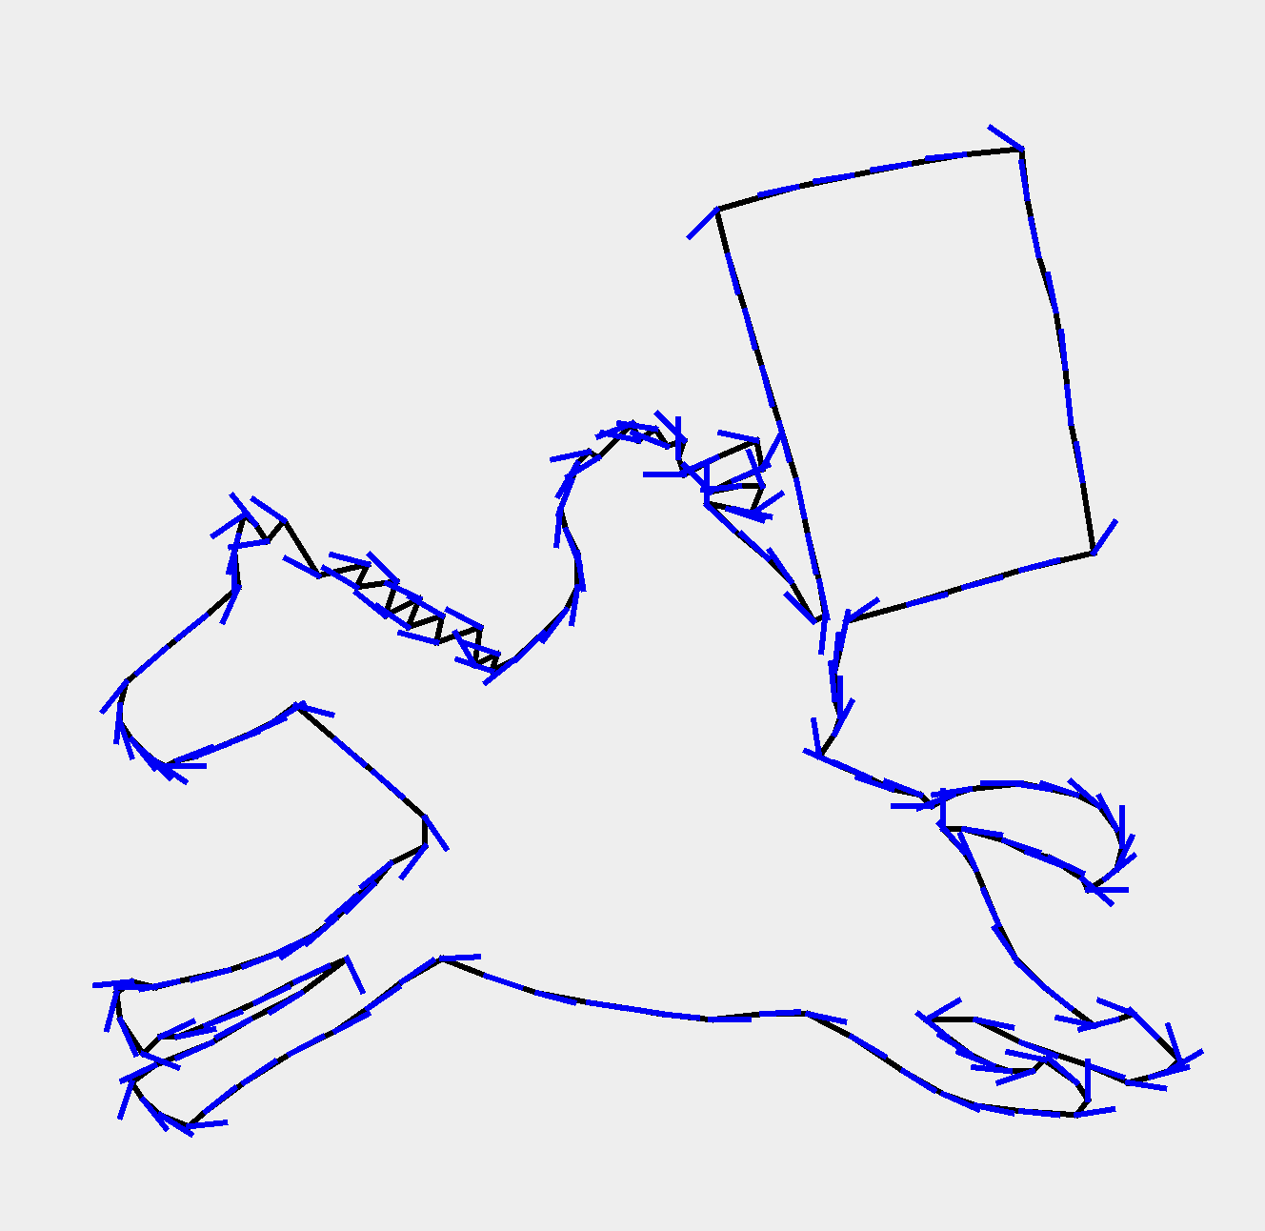
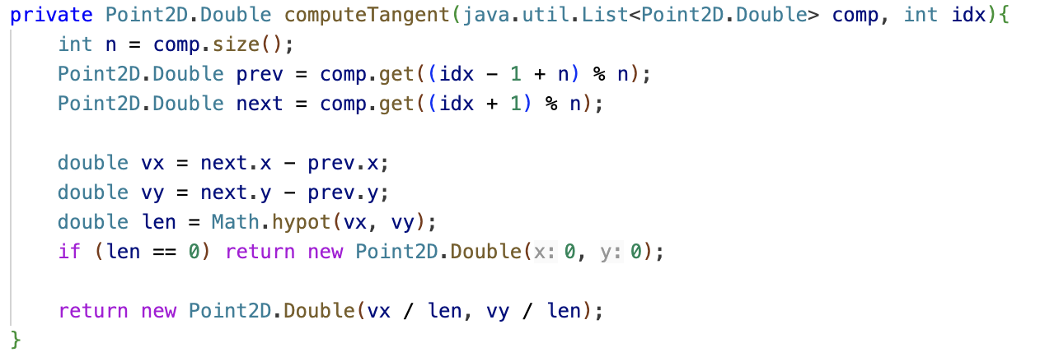
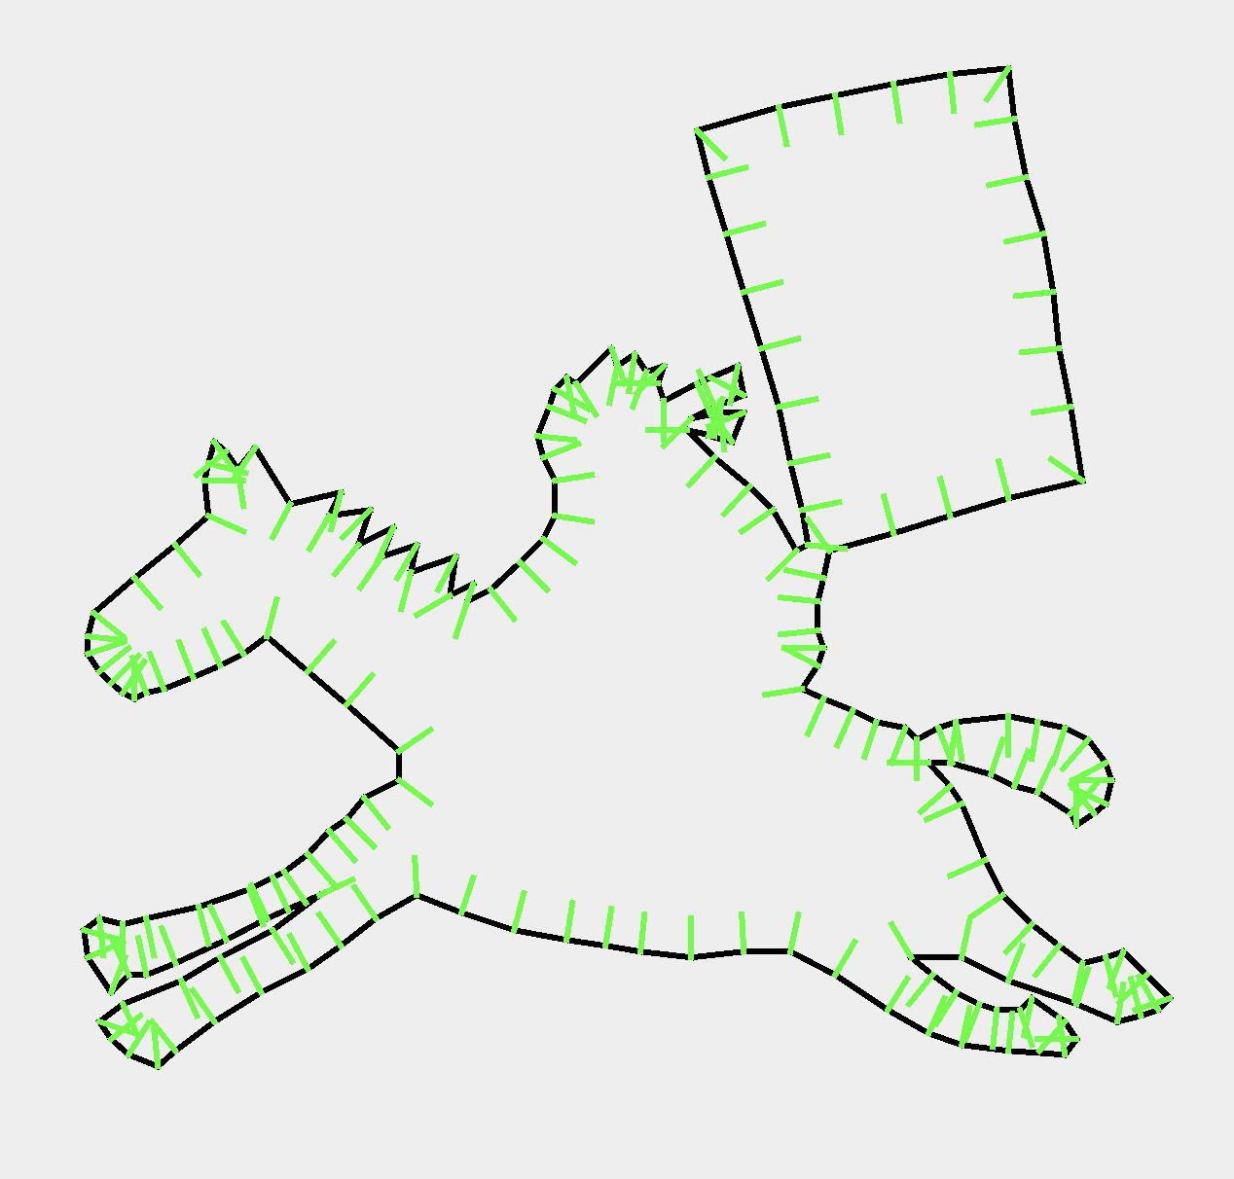
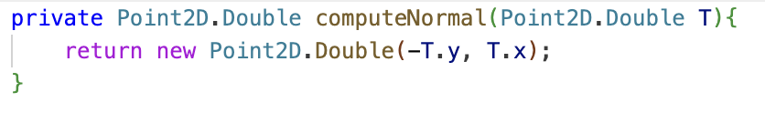
Visualize Tangent & Normal
Fig 1: Original riderr.vert
Unit Tangent Vector
Blue lines extend toward the tangent to the next vertex.
Unit Normal Vector
Green lines extend in the direction perpendicular to the curve.
Calculate by rotating the unit tangent by 90 degrees.
Fig 2: Unit Tangent Vector
Fig 3: Unit Normal Vector

Slide 3
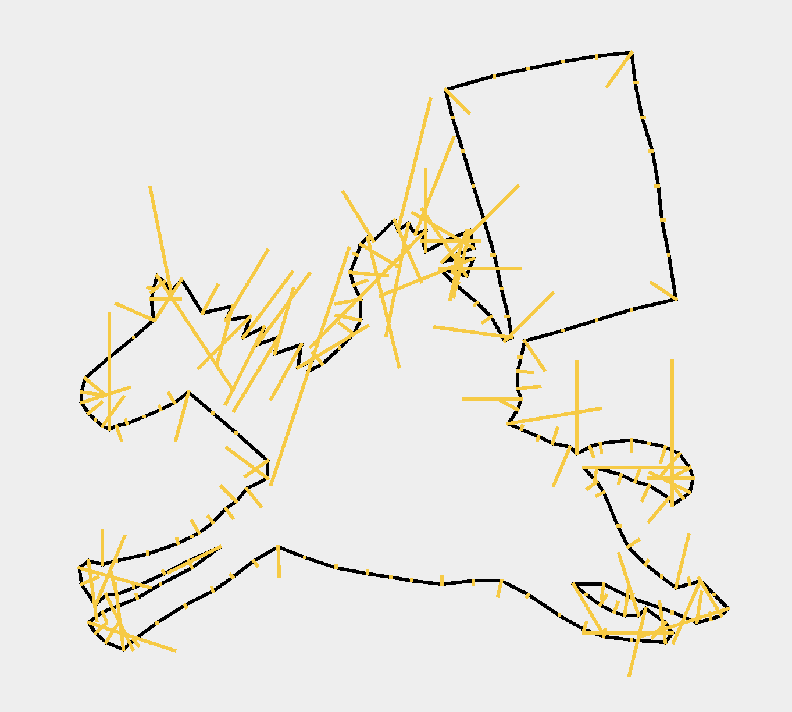
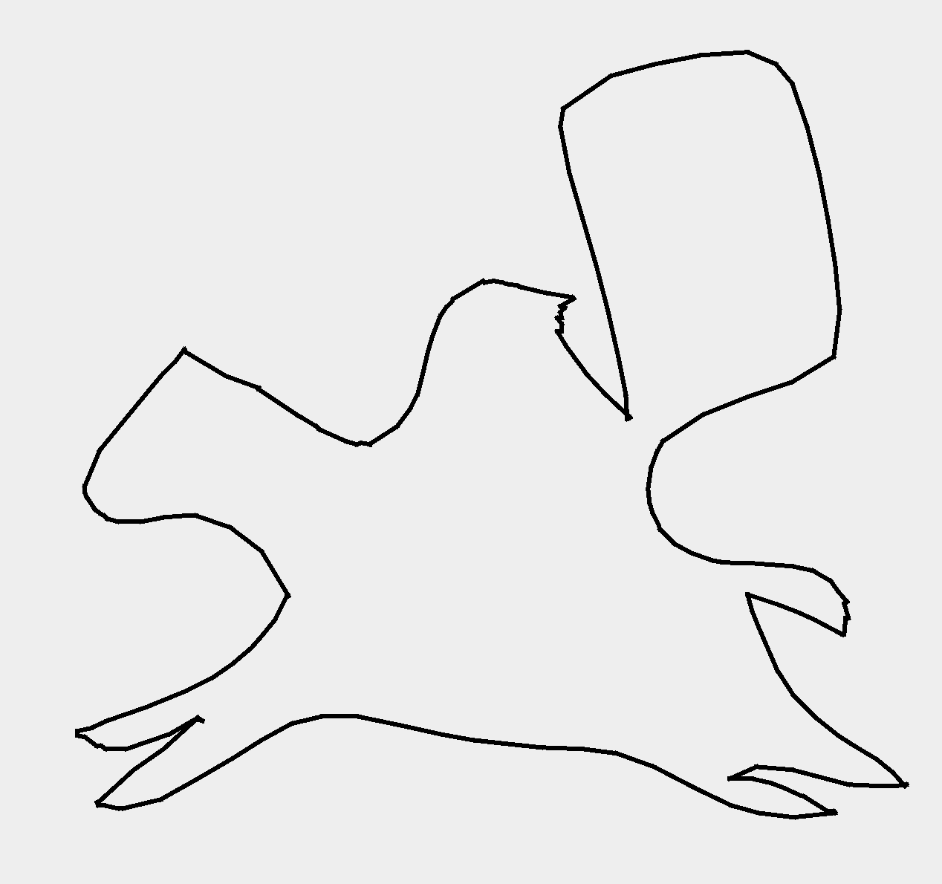
Curvature & Evolve Curve
Curvature
Orange lines represents curvature
The longer the line, the higher the curvature
Evolve the curve by curvature flow
Fig 4: Visualize curvature
Fig 5:The process of evolving curves

